Slide 1
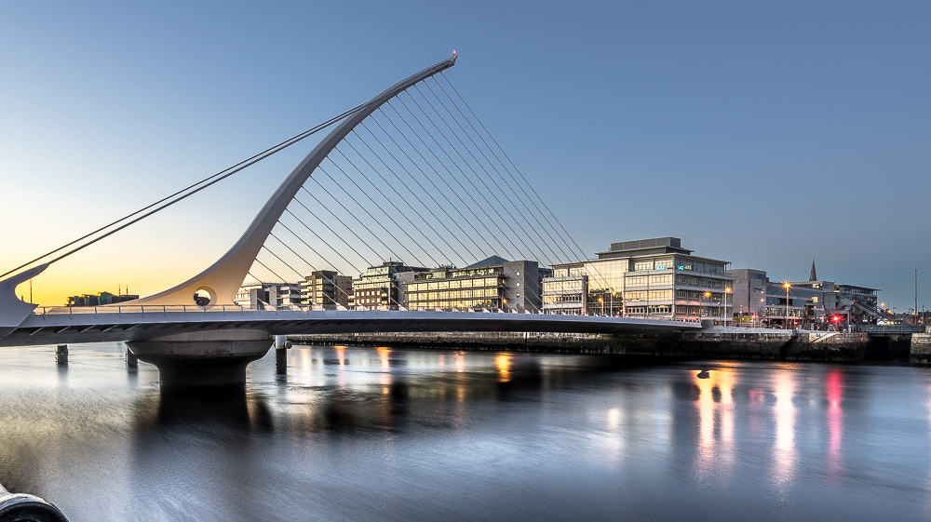
INCLUSIVE GROWTH: a multidimensional approach to sustainability
KHANH QUOC DUONG
Department of Sociology, Maynooth University, Ireland

Slide 2

CLIMATE & POVERTY
The Environemental dimension

Slide 3

HAPPINESS & HEALTH
The Social dimension

Slide 4

GLOBALISATION & TECHNOLOGY
the Economic dimension

